Slide 1
TERMINAL 3 LOUNGE ELIGIBILITY PROPOSALS AND INSIGHTS
George Daish, Ian Ma, Jamie Scragg
8 November 2023
Notes:
Jamie
Each summer season, we operate more than 11 and a half million seats from London Heathrow.
In our peak weeks, over 100,000 passengers are eligible to use our Heathrow lounges.
Our lounges form a key part of our Premium Proposition.
Also needed to secure London Leadership. It is one the key attractions of both status and premium cabins.
Terminal 3 forms a key part of our Heathrow operation, in 2019 it welcomed 15.5% of LHR pax including both short-haul and long-haul pax.

Slide 2
STRUCTURE
ASSUMPTIONS
PROPOSAL
REASONING
LIMITATIONS & FURTHER EXPLORATION
RECOMMENDATION ON TIER 1 LOUNGE IN TERMINAL 3
Notes:
Jamie
Re state the business problem
So getting this right is very important.
We will begin by outlining our assumptions.

Slide 3
Assumptions
Notes:
Jamie

Slide 4
Assumptions
No significant changes to lounge eligibility rules.
Lounge eligibility profiles in Summer 2025 will be comparable to previous years.
Aircraft cabin ratios will be broadly similar to previously.
BA customers will choose BA lounges over T3 OneWorld partner lounges.
Notes:
Jamie
We don’t expect drastic changes to the criteria by which lounge eligibility is calculated, both positive or negative.
For example, we do not expect the airline to introduce e.g. a discount club or First fares which does not include lounge access, or remove lounge access from Silver card holders or give it to Bronze. Or, even though this would be very nice, to give it to staff on premium standby fares.
We can only base it on previous years. Each of our broad groupings should be broadly similar to previous years.
Aircraft will not significantly change, so we won’t introduce a new business class only route from T3.
BA customers will choose the BA lounge. They are eligible to access the OneWorld partner lounges, but we assume they won’t at this stage. Also OneWorld partner customers won’t come to BA lounge.
These affect lounge uptake rate and so is something the lounge sizing team will have to consider in the next stage.

Slide 5
Our Proposal
Notes:
George

Slide 6
Lookup Table
FIRST_SEATS_BINS | Country Group (SH)/ Continent Group (LH) | COUNTRY_NM | Not_Eligible | Tier_1 | Tier_2 | Tier_3
0 | AFRICA | All | 79.62% | 0.37% | 4.27% | 15.74%
0 | ASIA FAR EAST | All | 80.97% | 0.24% | 3.31% | 15.47%
0 | ASIA SOUTH EAST AND CENTRAL | All | 80.11% | 0.21% | 3.11% | 16.57%
0 | AUSTRALASIA PACIFIC | All | 79.73% | 0.29% | 4.16% | 15.82%
0 | EUROPE EXC UK | All | 78.25% | 0.70% | 6.22% | 14.82%
0 | MIDDLE EAST | All | 78.46% | 0.44% | 5.40% | 15.70%
0 | NORTH AMERICA | Canada | 80.67% | 0.24% | 3.36% | 15.73%
0 | NORTH AMERICA | USA & Bermuda | 79.13% | 0.16% | 4.03% | 16.68%
0 | SOUTH AMERICA INC CARIBBEAN | All | 80.81% | 0.19% | 3.16% | 15.84%
7-10 | AFRICA | All | 71.01% | 3.14% | 5.08% | 20.77%
7-10 | ASIA FAR EAST | All | 73.96% | 2.28% | 4.15% | 19.61%
7-10 | ASIA SOUTH EAST AND CENTRAL | All | 73.49% | 2.69% | 3.95% | 19.87%
7-10 | AUSTRALASIA PACIFIC | All | 62.78% | 3.36% | 7.44% | 26.42%
7-10 | EUROPE EXC UK | All | 67.68% | 1.85% | 10.32% | 20.14%
7-10 | MIDDLE EAST | All | 72.62% | 3.51% | 5.20% | 18.67%
7-10 | NORTH AMERICA | Canada | 75.57% | 0.85% | 4.28% | 19.29%
7-10 | NORTH AMERICA | USA & Bermuda | 69.56% | 3.32% | 5.95% | 21.17%
7-10 | SOUTH AMERICA INC CARIBBEAN | All | 75.40% | 2.86% | 3.48% | 18.26%
11-17 | AFRICA | All | 73.03% | 3.63% | 4.72% | 18.62%
11-17 | ASIA FAR EAST | All | 72.08% | 4.29% | 5.00% | 18.63%
11-17 | ASIA SOUTH EAST AND CENTRAL | All | 69.81% | 4.93% | 4.41% | 20.85%
11-17 | AUSTRALASIA PACIFIC | All | 70.11% | 3.56% | 6.42% | 19.91%
11-17 | EUROPE EXC UK | All | 66.60% | 4.91% | 7.99% | 20.50%
11-17 | MIDDLE EAST | All | 66.62% | 5.12% | 6.22% | 22.03%
11-17 | NORTH AMERICA | Canada | 74.13% | 3.92% | 3.06% | 18.89%
11-17 | NORTH AMERICA | USA & Bermuda | 69.49% | 4.39% | 5.44% | 20.69%
11-17 | SOUTH AMERICA INC CARIBBEAN | All | 73.45% | 4.34% | 3.34% | 18.86%
SH | BENELUX | All | 74.83% | 0.64% | 7.46% | 17.07%
SH | EASTERN EUROPE | All | 80.57% | 0.26% | 4.35% | 14.82%
SH | IRELAND RO | All | 75.65% | 0.61% | 6.53% | 17.22%
SH | MEDITERRANEAN | All | 74.59% | 0.33% | 5.33% | 19.75%
SH | MIDDLE EAST OTHER | All | 78.34% | 0.14% | 3.62% | 17.90%
SH | NORTH AFRICA | All | 76.10% | 0.28% | 3.77% | 19.85%
SH | SCANDINAVIA | All | 76.83% | 0.49% | 6.43% | 16.25%
SH | UK | All | 76.81% | 0.39% | 5.34% | 17.47%
SH | WEST EUROPE | All | 75.82% | 0.45% | 6.30% | 17.43%
LONG HAUL | SHORT HAUL
Defined by cabin selling class
Number of First seats | Country Group
Continent (exc. N Am.)
Eligibility %
Notes:
George:
We chose to divide the table into short haul and long haul as they have very different properties
This was decided by the cabin selling class, e.g. if they sold premium economy it was classed long haul
We then went to divide long haul up into the number of first class seats offered, this enables us to get a “premium” factor which correlated well with tiered pax
Then we wanted to regionally divide both SH AND LH, into continent and country group respectively.
We had to be more granular for SH as it is really only the European market where as
However, for North America we also wanted to be more granular as this represents a large proportion of our LH network

Slide 7
Reasoning

Slide 8
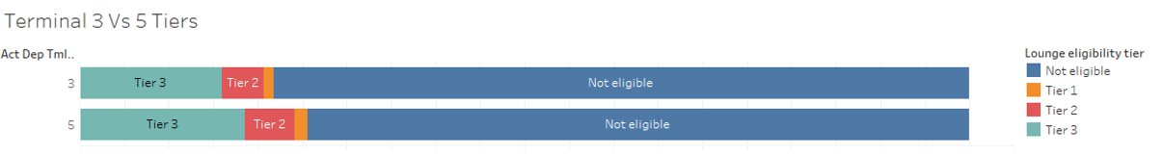
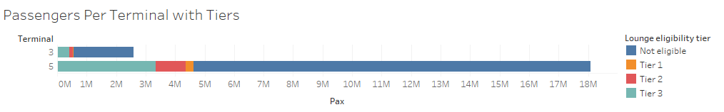
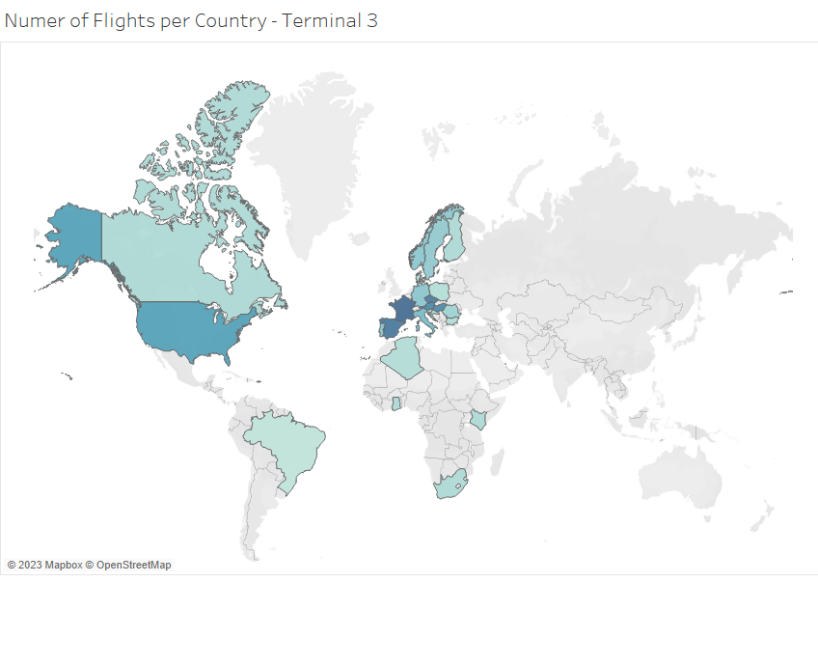
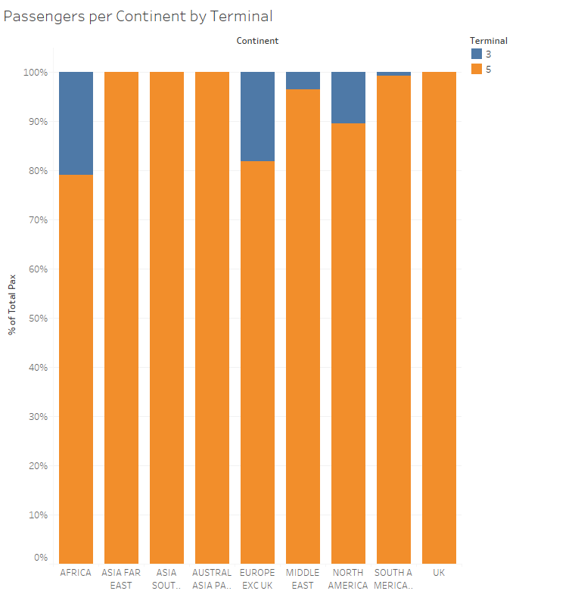
OUR ANALYSIS: Terminal 3 & Terminal 5
Lounge eligibility profiles are similar in T3 and T5.
Terminal 3 has a slightly less premium customer base
Notes:
George
We figured that Terminal 3 has a slightly less premium profile, hence there are less tiered pax as a percentage
Terminal 3 handles far less pax when compared to terminal 5
The map shows where we fly to from T3
Although we don’t know what routes will operate from t3 in 2025, we assume that they will follow the same trends of being less premium
The graph shows what percentage of flights go from t3/t5, you can see that there are significant chunks in Africa and Europe with a bit of north America and middle east
We have decided to use data from both terminals in the formation of our lookup table as we do not know what routes might change terminal and we believe the makeup of the terminal profiles come from their routes

Slide 9
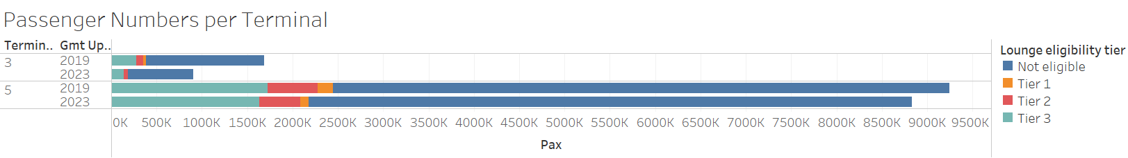
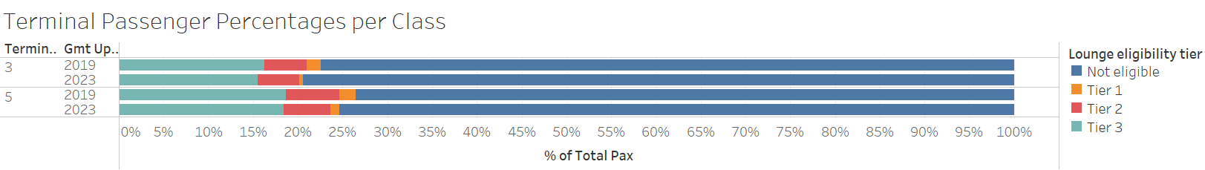
WHY COMBINE 2019 AND 2023?
2019 shows the data before the age of video conference/COVID and 2023 shows the latter
Asia market heavily affected by flying ban
Expecting the return of business customers post COVID
Notes:
George
We combined all the data from 2019 and 2023 to form our table and analysis.
We predict that 2025 will fall somewhere between the profiles of 2023 and 2019, we predict that the business market will increase towards 2019
But the leisure market will be larger that 2019 due to our new ways of working and VFR travel
2023 lacked data from specific regions due to many geopolitical reasons
Proportions of data from 2023 were missing or contained errors resulting in less data available

Slide 10
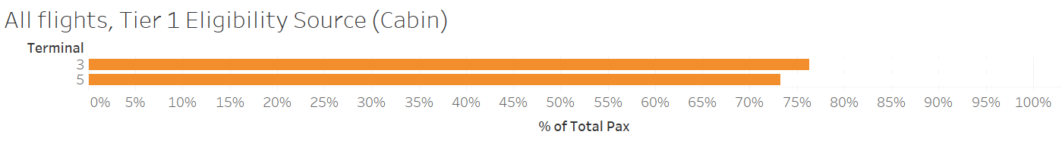
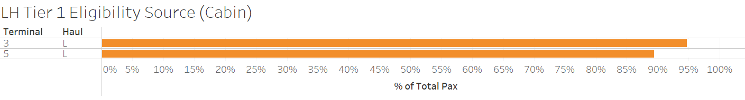
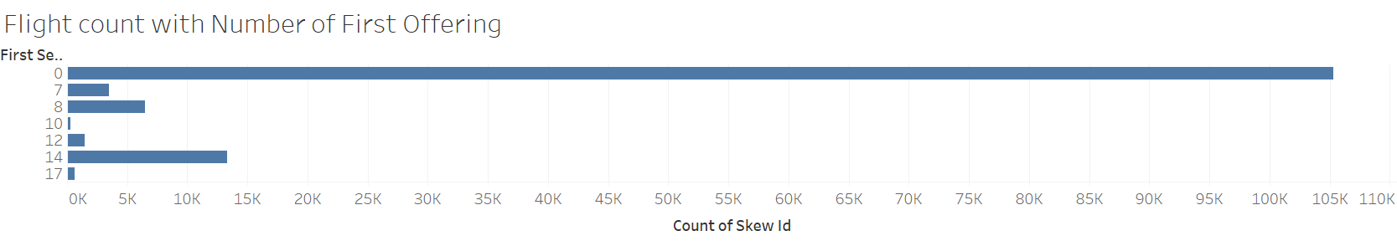
WHY INCLUDE THE BREAKDOWN BY FIRST SEATS?
Overwhelming majority of Tier 1 customers get their lounge access by flying First, not status.
Very few flights had 10, 12 or 17 seats in First.
NOTE: We cannot break down SH due to the dynamic sizing of CE cabin.
Notes:
Ian
Break Down from First for Long Haul:
Vast Majority of T1 gain eligibility by seat
2. Group First seats number due to few flight's on 10,12,17 seats
No club for both Hauls
LH: Continent more powerful
SH: Dynamic cabin sizing (Curtain)
No actual number, varies through booking
Example: Edinburgh
10 rows of Club in weekdays
4 rows of Club in weekends

Slide 11
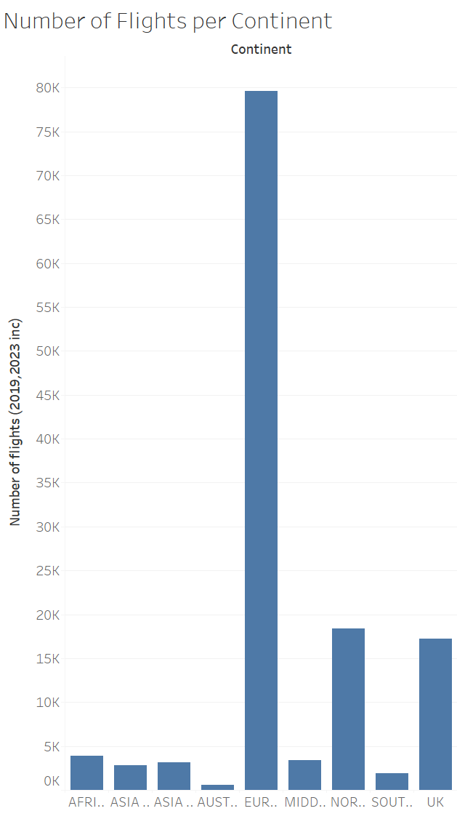
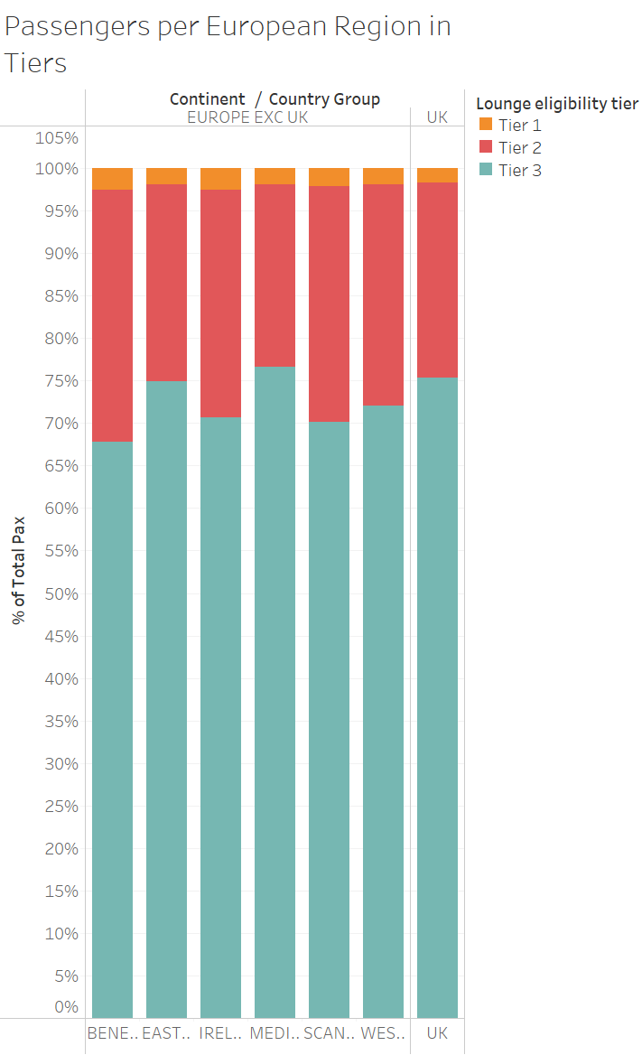
WHY BREAKDOWN BY CONTINENT (LH) AND COUNTRY GROUP (SH, NORTH AMERICA)
small number of flights in region
New possible route
However, we need more granular results for North America and SH
Notes:
Ian
Here I will explain why are we breaking down different hauls differently
LH:
Significantly small number of flights to these continents
Too granular if split into groups
Accommodate New destination
Eg. Taiwan
SH, NAm:
2 largest markets for BA and arge Difference between Country Groups on Tiers, needs more granularity
EG, Benelux vs Eastern Europe
5% of difference between Tier 3 out of all Eligibilities
80K flights to Europe, that’s will be a huge difference
Region: No possible route and low number of flights

Slide 12
Design Limitations & Further Exploration
Notes:
Ian

Slide 13
Limitations and Further Exploration
Limitations
Further Exploration
Peak week for 2025 unknown
No Winter data
Cannot accommodate significant cabin size changes
Departure the time of the day
Status vs Eligibility
Connecting Traffic
Notes:
Ian
Limitation
No peek week details for 2025, although we have peek weeks for 2019 and 2023
We have no Winter Data, which can varies a lot from Summer Data
Different Seasons
Cannot accommodate significant cabin size changes
Only do between 0 to 17 First seats, cannot do >17 Frist
Further Exploration
Departure time of the day
We don't have 25 schudule
Status vs Eligibility
How Status will changes the eligibility
If we can use predictions of eligibility to predict eligibility
Connecting Traffic
Eg. Disregard short connections, no reason to use lounge if you have a flight in 20 minutes

Slide 14
Should a tier 1 lounge be built in terminal 3?
Notes:
Jamie

Slide 15
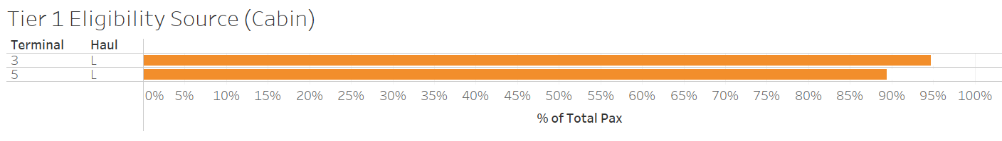
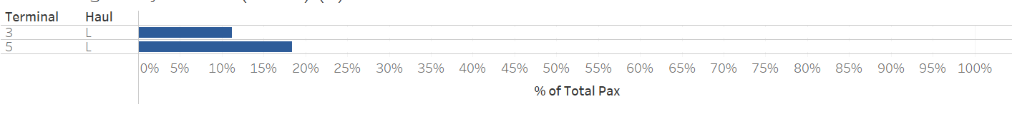
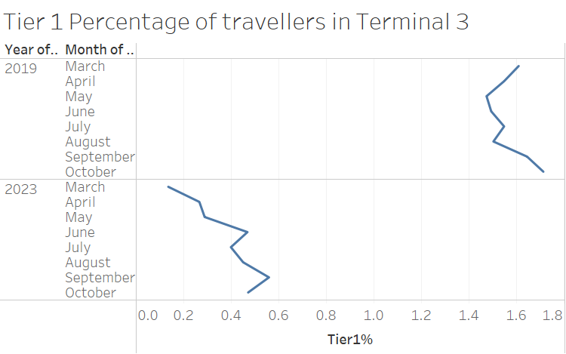
Recommendations: Tier 1 Lounge in Terminal 3?
Orange: % deriving access from cabin
Blue: % deriving access from status
Year | Terminal | Tier 1 eligibility % | Daily Tier 1 eligibility
2019 | 3 | 1.55% | 125
2019 | 5 | 1.84% | 809
2023 | 3 | 0.41% | 19
2023 | 5 | 1.02% | 455
Notes:
Jamie
We are not recommending a Tier 1 lounge.

Slide 16
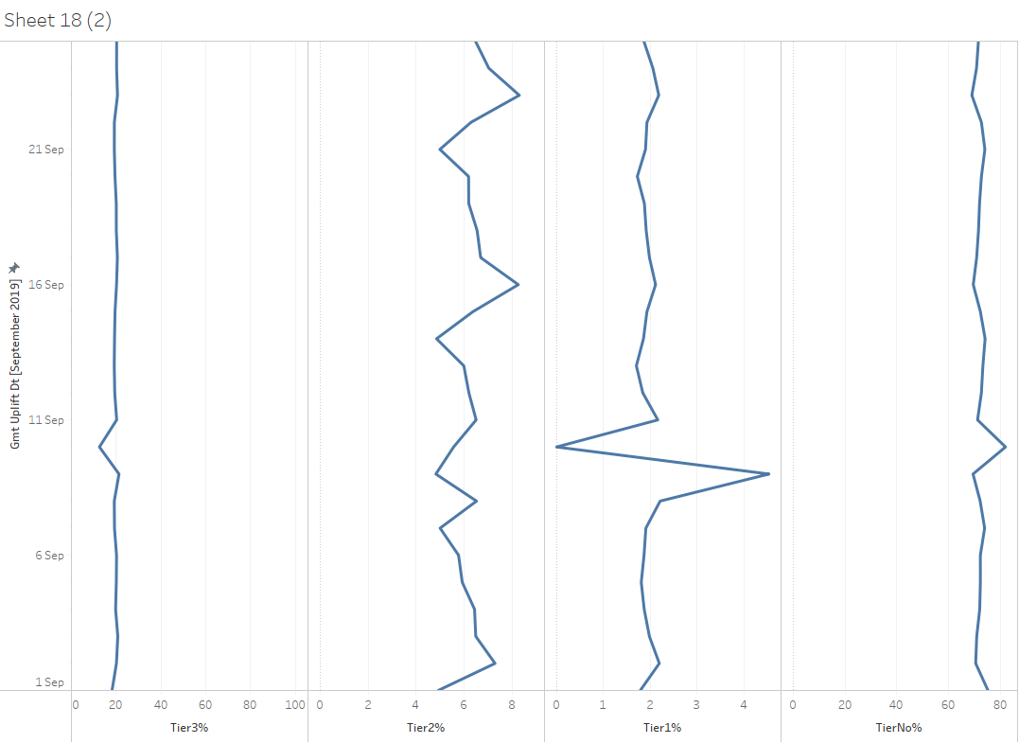
Did you know?
Notes:
Jamie

Slide 17
Notes:
Jamie

